Slide 1
Updates on Modeling Bus-based Fabric
Anuparna
26th Jan 2026

Slide 2
Agenda
Modeling bus-based fabric in DSL
cycle accurate simulator for the bus-based fabric configuration

Slide 3
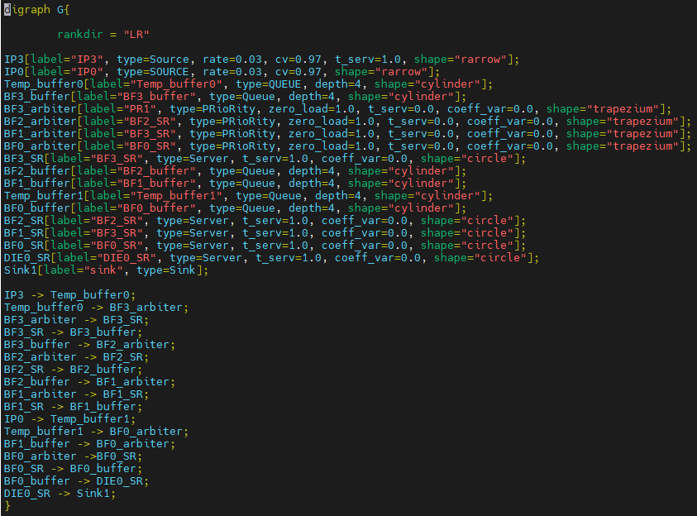
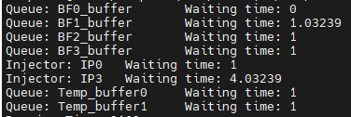
Die0
Modeling bus-based fabric in DSL
Die1
Converted to .dot file
BF0
IP0 , IP3 are injectors[type: source]
And injected into temp_buffer first.
Each BF’s zero_load = 1 represents fixed one cycle delay.
IP3 traverses BF3 → BF2 → BF1 → BF0 → Die0 so IP3’s end-to-end latency = W(temp_buffer0) + W(BF3) + W(BF2) + W(BF1) + W(BF0)
IP0 traverses BF0 → Die0 so IP0’s end-to-end latency = W(temp_buffer1) + W(BF0)
BF(Bus Fabric) Setup
IP0
BF1
BF3
BF2
IP3
Input from Intel
Meaning of shapes in the diagram:
Arrow : Injector. [IP0, IP3]
Cylinder : buffer [temp_buffer, BF_buffer]
Trapezium : arbiter [BF_arbiter]
Circle : server
BF is the fabric instance and every BF has arbitration
IPs are the injectors and both IP0 and IP3 are sending packets to Die0. (assumption, IP0 packets have higher priority than IP3)
IP0 pkts and IP3 pkts arbitrate at PSF0.
Each BFs(BF0, BF1, BF2, BF3) causes 1 cycle delay (from input port to output) in addition to the arbitration. If no arbitration at a said BF, then assume delay = 1 cycle
Output verified on pen and paper

Slide 4
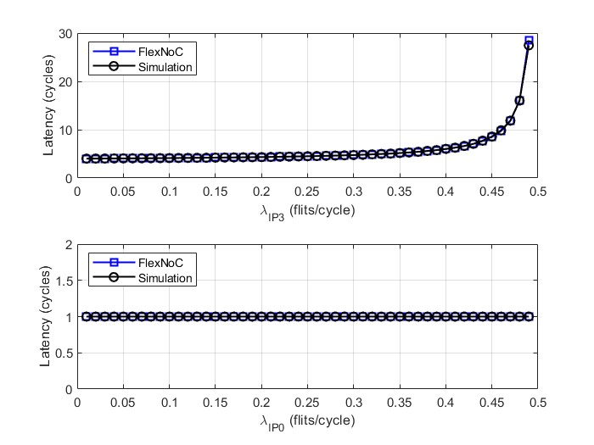
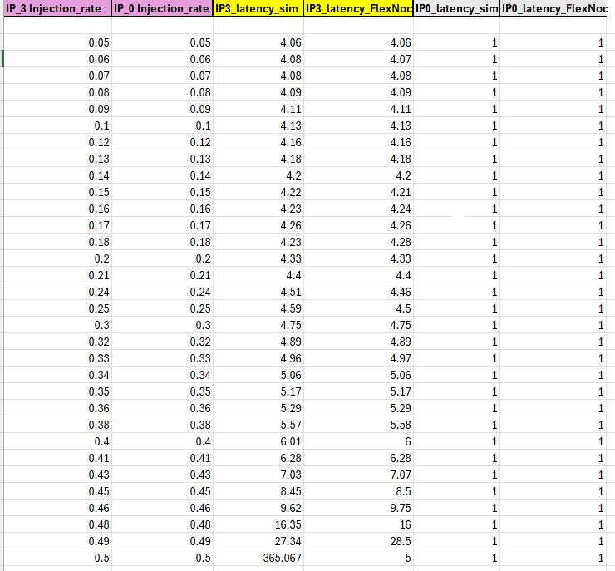
Cycle-accurate Simulation Vs FlexNoC for the given Configuration
Cycle accurate simulator construction:
Discrete-time model (Each loop = 1 clock cycle).
Packets injected at IP0/IP3 (injection rate-based), queued separately.
IP3 has fixed pipeline delay (BF3→BF2→BF1).
BF0–Die0 modeled as single server with fixed service time.
Latency is measured from injection to exit at Die0, and average latency is computed over all packets.
Latency comparison between cycle-accurate simulation and FlexNoC for IP0 and IP3
MAPE ≈ 0.20%
MAE ≈ 0.03
G
GitHub link

